Slide 1
Accounting & Finance
Final Exam Case Study
Tesla Motors – Evaluating a Growth Company
Questions & Pointers

Slide 2
Questions and Pointers
Tesla Motors - Evaluating a Growth Company; HBSP case study # A-209. Your case solution should include your answers / analysis for the following:
1. BACKGROUND - What are the risks for Tesla? What are advantages / disadvantages of their business model? What issues do they face? Do they have strategic partner(s)?

Slide 3
Questions and Pointers
2. What are your "Projections" for Tesla's financial results; including revenues, costs, expected free cash flow etc through 2025? Be sure to identify your assumptions. When do you expect Tesla to start making consistent profits?
3. What is your estimate of Tesla's WACC?
4. Use the above to create a discounted cash flow analysis for Tesla.

Slide 4
Questions and Pointers
5. Based on above determine Tesla's "Enterprise" value.
What is the corresponding value per share?

Slide 5
Questions and Pointers
6. Compare the per share valuation that you calculated to current market value of a Tesla share of common stock. Is current market value reasonable vis-a-vis the value you calculated? If there is a difference between market value and the value that you have derived, is the stock currently over or undervalued? What might be the reason(s) for such a difference?
Be sure to include written as well as spreadsheet submissions.

Slide 6
Tesla Pointers
Use all your knowledge gained throughout the course
Research should include finding current beta; debt level, Profitability, level of Free Cash Flow etc.
Use SEC web site
Also use recent financial press articles / research analyst information

Slide 7
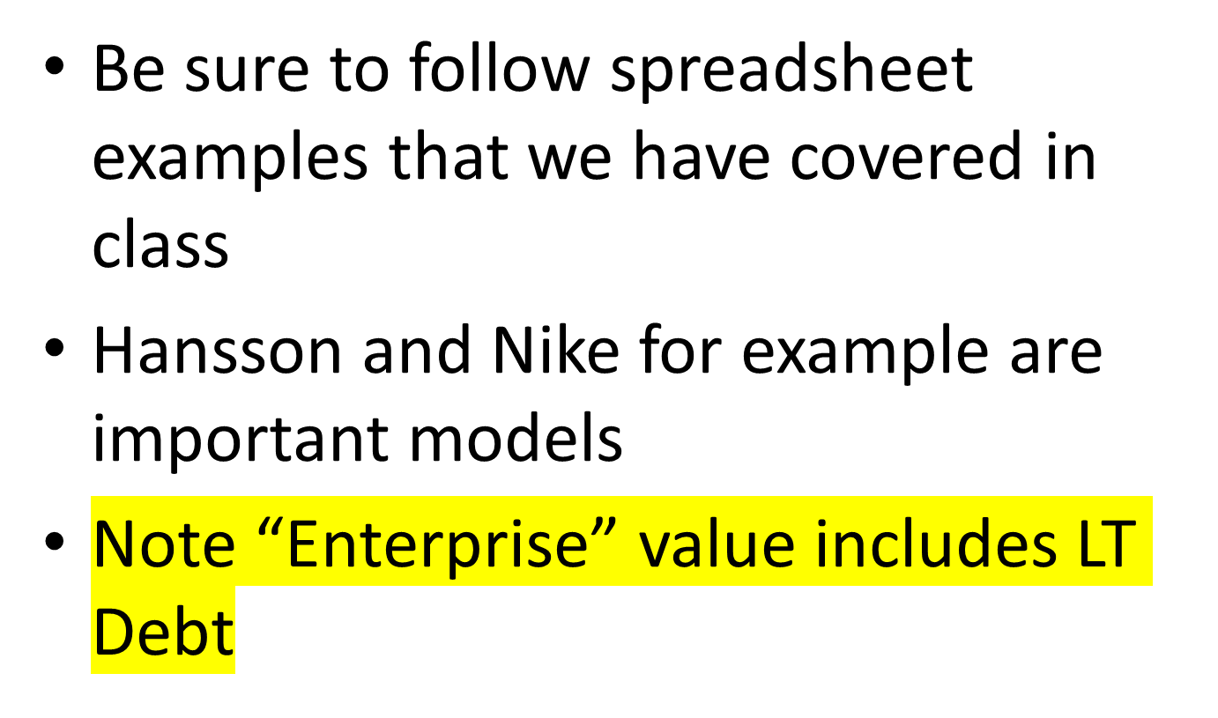
Tesla Pointers

Slide 8
Tesla Pointers
Don’t forget Sensitivity analysis
In this context think about / comment on Tesla’s revenue resulting from sales of “government energy credits”
Also be sure to comment on their level of “Solvency” based on their most recently issued Financial Statements (10Q dated 9/30/18)

Slide 9
Pointers
Several recent important matters to be sure to consider including:
Possible Tariff impact?
Recent News of Chevy Volt and other competing cars.
Information that Tesla will issue new Long Term debt of approx. $837 million! Backed by auto leases.

